Slide 1
Fluid flow
COMPRESSIBLE FLOW

Slide 2
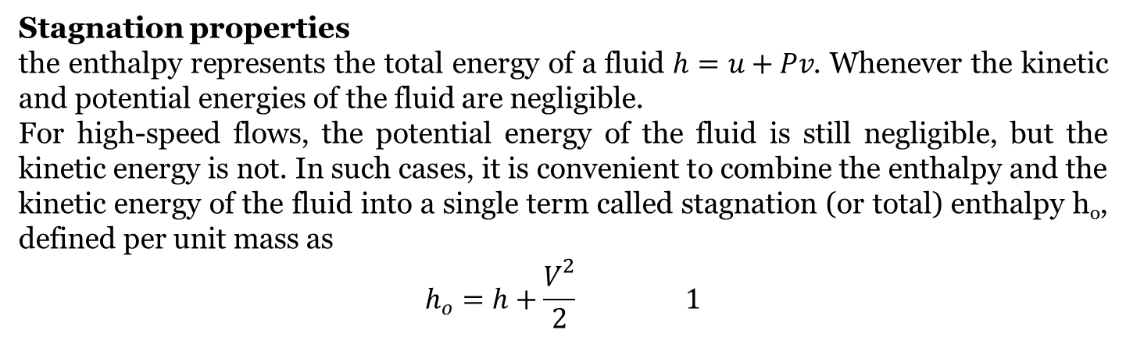
Introduction
Fluids flow which involve significant changes in density are called compressible flows
They are encountered in devices that involve the flow of gases at very high speeds. Compressible flow combines fluid dynamics and thermodynamics in that
both are necessary to the development of the required theoretical background.
Stagnation properties
the enthalpy represents the total energy of a fluid $h=u+Pv$. Whenever the kinetic and potential energies of the fluid are negligible.
For high-speed flows, the potential energy of the fluid is still negligible, but the kinetic energy is not. In such cases, it is convenient to combine the enthalpy and the kinetic energy of the fluid into a single term called stagnation (or total) enthalpy h_{o}, defined per unit mass as
$$h_{o}=h+\frac{V^{2}}{2} 1$$

Slide 3
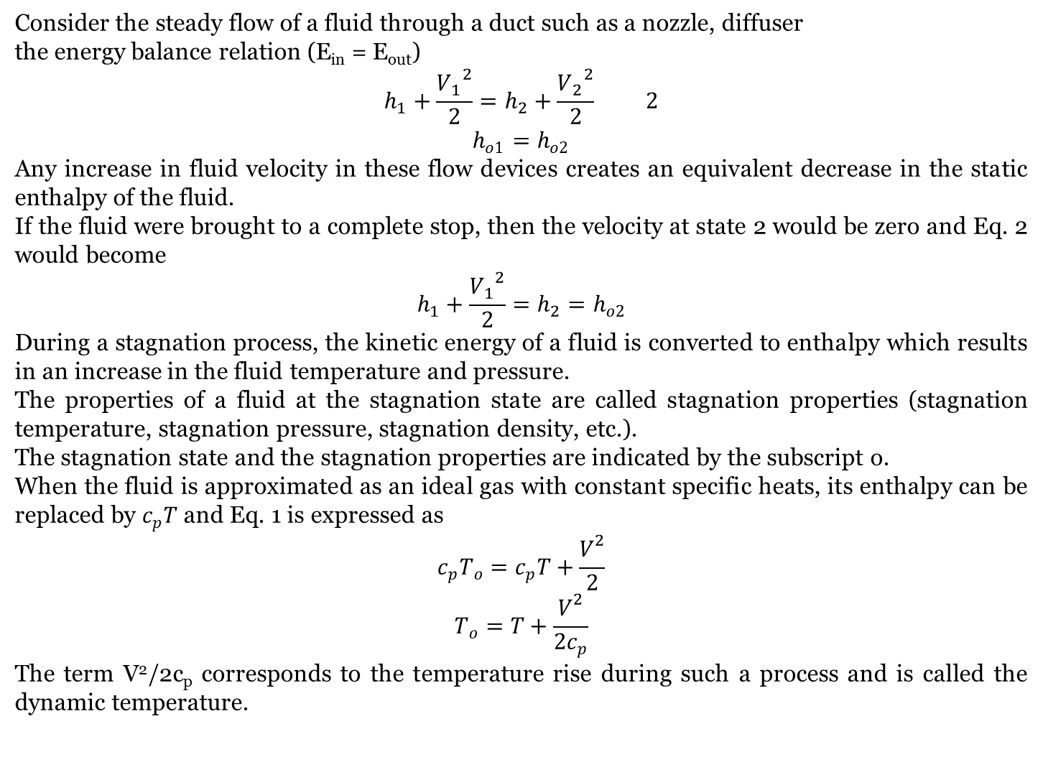
Consider the steady flow of a fluid through a duct such as a nozzle, diffuser
the energy balance relation (E_{in} = E_{out})
$$h_{1}+\frac{{V_{1}}^{2}}{2}=h_{2}+\frac{{V_{2}}^{2}}{2} 2$$
$$h_{o1}=h_{o2}$$
Any increase in fluid velocity in these flow devices creates an equivalent decrease in the static enthalpy of the fluid.
If the fluid were brought to a complete stop, then the velocity at state 2 would be zero and Eq. 2 would become
$$h_{1}+\frac{{V_{1}}^{2}}{2}=h_{2}=h_{o2}$$
During a stagnation process, the kinetic energy of a fluid is converted to enthalpy which results in an increase in the fluid temperature and pressure.
The properties of a fluid at the stagnation state are called stagnation properties (stagnation temperature, stagnation pressure, stagnation density, etc.).
The stagnation state and the stagnation properties are indicated by the subscript o.
When the fluid is approximated as an ideal gas with constant specific heats, its enthalpy can be replaced by $c_{p}T$ and Eq. 1 is expressed as
$$c_{p}T_{o}=c_{p}T+\frac{V^{2}}{2}$$
$$T_{o}=T+\frac{V^{2}}{2c_{p}}$$
The term V²/2c_{p} corresponds to the temperature rise during such a process and is called the dynamic temperature.

Slide 4
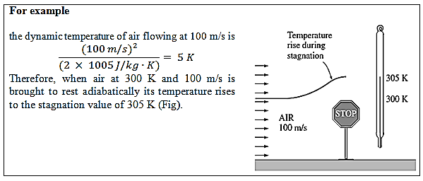
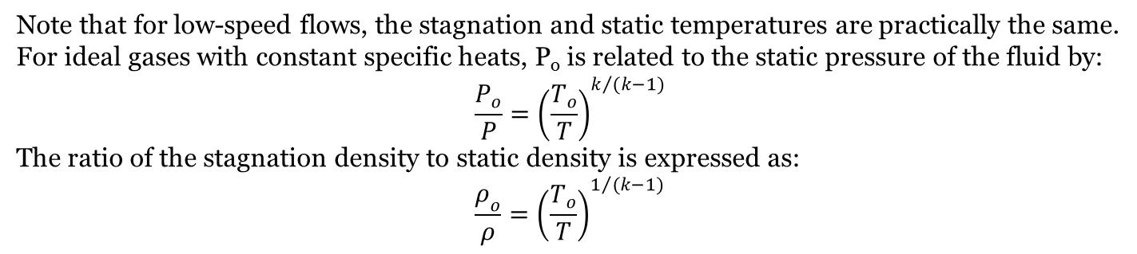
Note that for low-speed flows, the stagnation and static temperatures are practically the same.
For ideal gases with constant specific heats, P_{o} is related to the static pressure of the fluid by:
$$\frac{P_{o}}{P}={\left(\frac{T_{o}}{T}\right)}^{k/{(k−1)}}$$
The ratio of the stagnation density to static density is expressed as:
$$\frac{ρ_{o}}{ρ}={\left(\frac{T_{o}}{T}\right)}^{1/{(k−1)}}$$

Slide 5
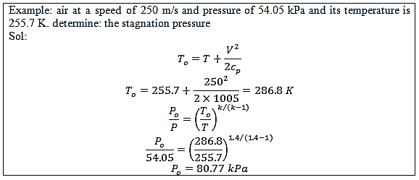

Slide 6
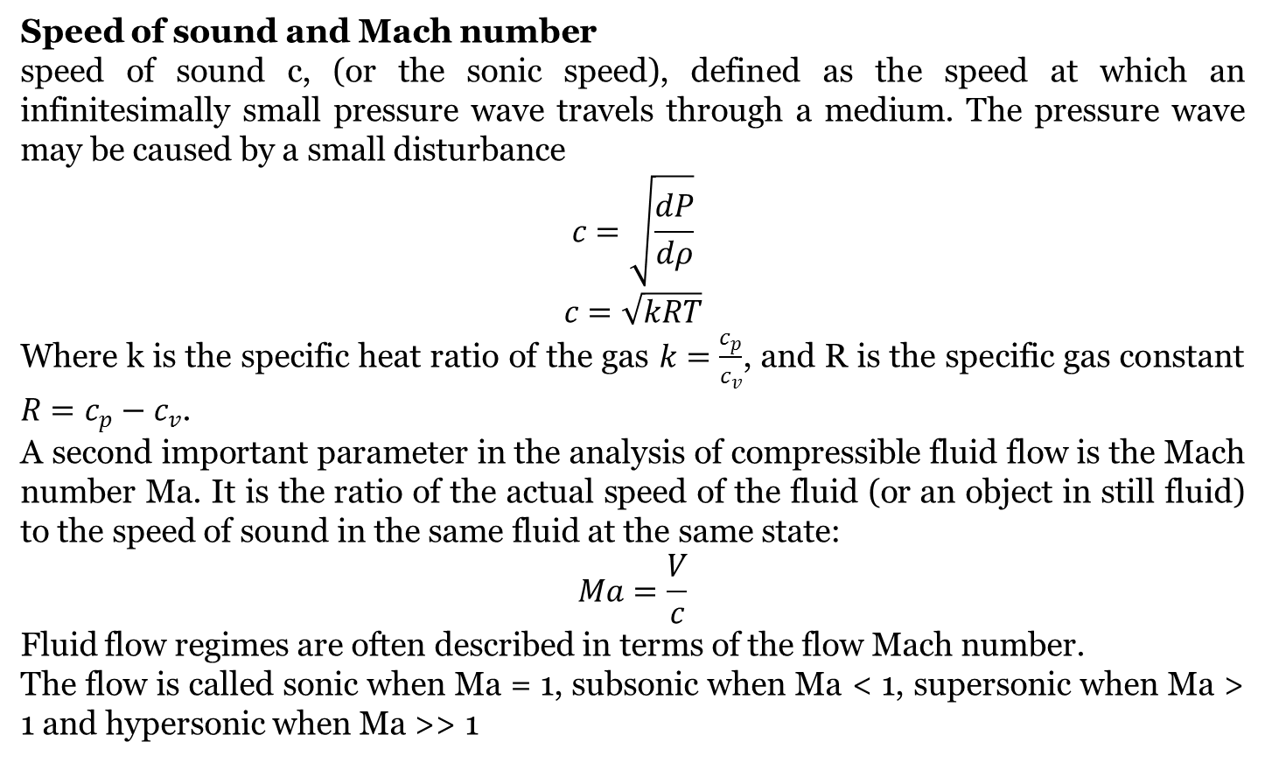
Speed of sound and Mach number
speed of sound c, (or the sonic speed), defined as the speed at which an infinitesimally small pressure wave travels through a medium. The pressure wave may be caused by a small disturbance
$$c=\sqrt{\frac{dP}{dρ}}$$
$$c=\sqrt{kRT}$$
Where k is the specific heat ratio of the gas $k=\frac{c_{p}}{c_{v}}$, and R is the specific gas constant $R=c_{p}−c_{v}$.
A second important parameter in the analysis of compressible fluid flow is the Mach number Ma. It is the ratio of the actual speed of the fluid (or an object in still fluid) to the speed of sound in the same fluid at the same state:
$$Ma=\frac{V}{c}$$
Fluid flow regimes are often described in terms of the flow Mach number.
The flow is called sonic when Ma = 1, subsonic when Ma < 1, supersonic when Ma > 1 and hypersonic when Ma >> 1

Slide 7
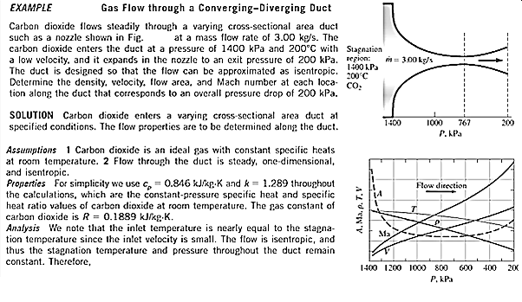
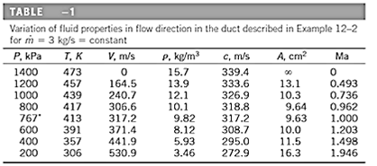

Slide 8
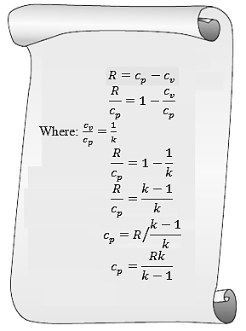

Slide 9
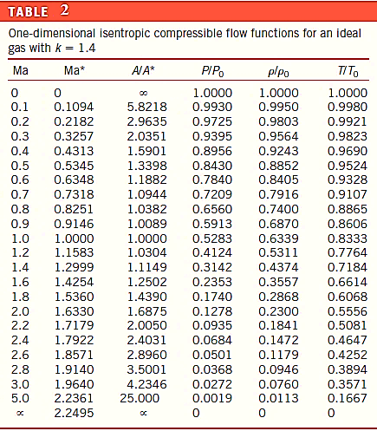

Slide 10
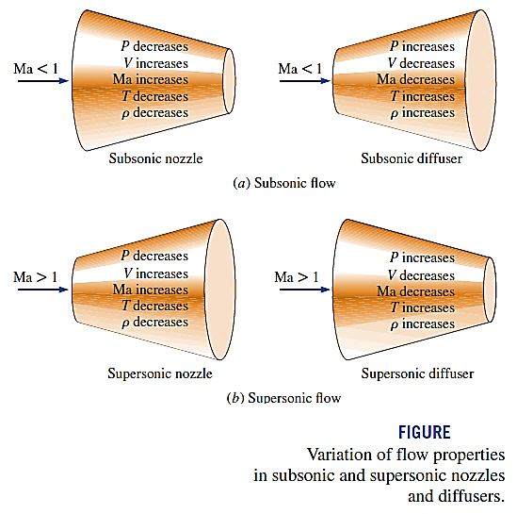
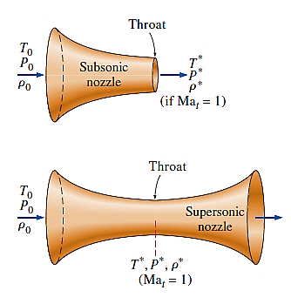

Slide 11
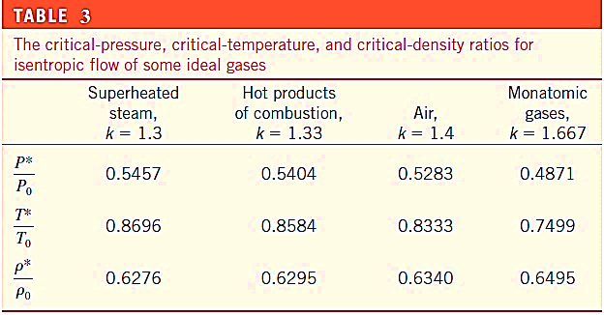

Slide 12
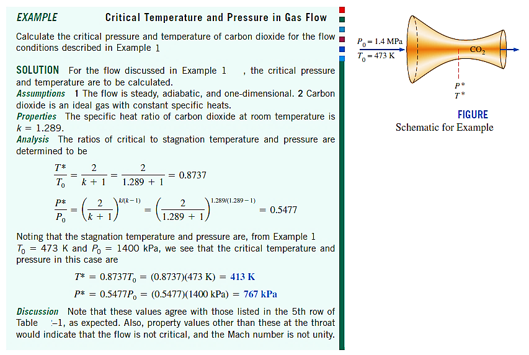

Slide 13
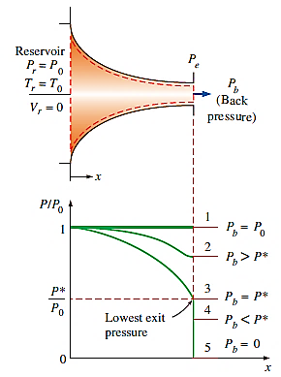

Slide 14
